Slide 1

T-joint
Politecnico di Torino – MSc Automotive Engineering
Numerical Modelling and Simulation – Part A – prof. Alessandro Scattina
Accademic year 2024/2025
Tommaso Massone

Slide 2
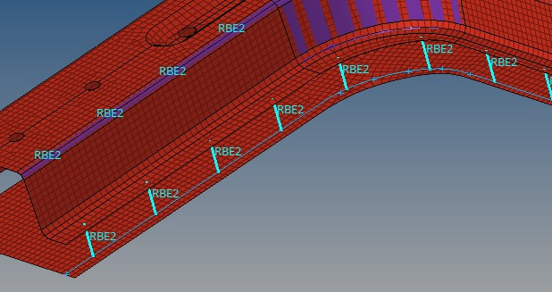
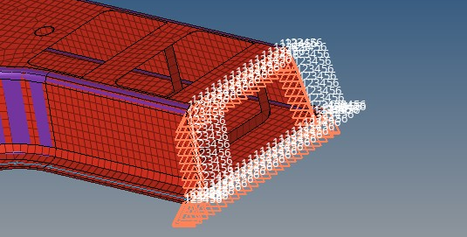
Creation of the model
Import of top and bottom part of the joint
Creation of spot welds, defining the line of the spot and the 2 surfaces that have to be welded together – step of 50mm
Reflect and duplicate the model in order to have a symmetric T instead of an L
Apply constraints on the lower part of the joints
Create the master node on the top of the piece and then apply the different load

Slide 3
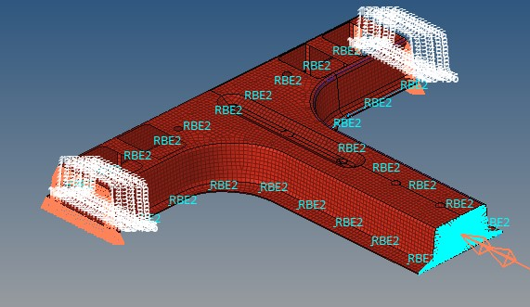
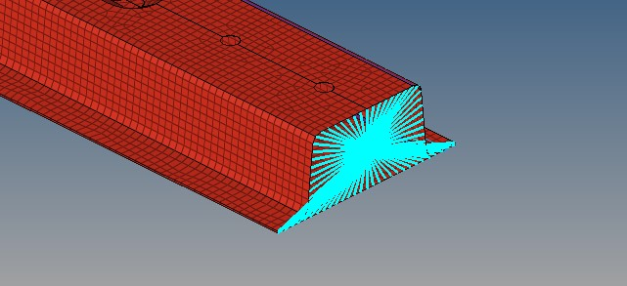
General configuration, obviously, loads change in the different cases
Master node where force and moment will be applied

Slide 4
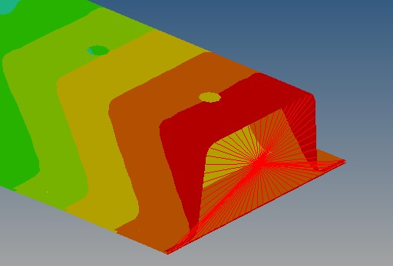
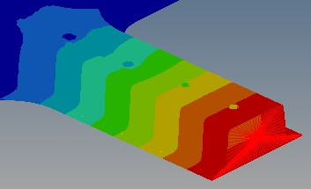
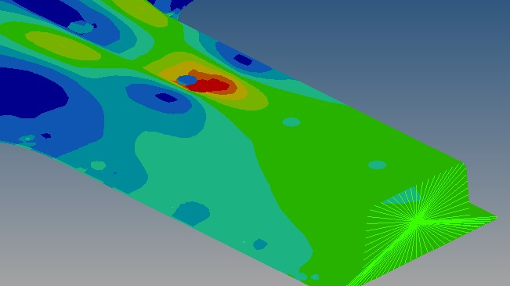



Bending stiffness
Bending due to force along X axis
$$K_{z}=\frac{F}{∆x}=4363\frac{N}{mm}$$
Value of displacement and rotation are taken in the most solicited point of the structure.
In this way it is found the minimum stiffness of the body, as it is assumed the most critical point in design condition
Bending due to force along Z axis
$$K_{x}=\frac{F}{∆z}=41 \frac{N}{mm}$$
Torsional stiffness
$$K_{y}=\frac{C}{α}=17425\frac{Nm}{rad}$$

Slide 5
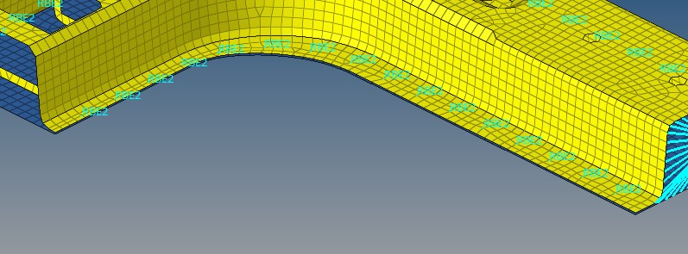
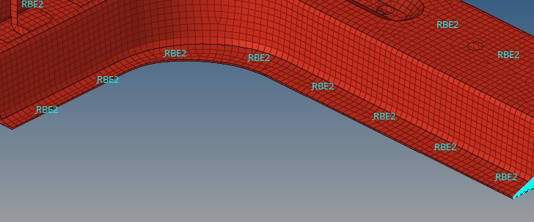
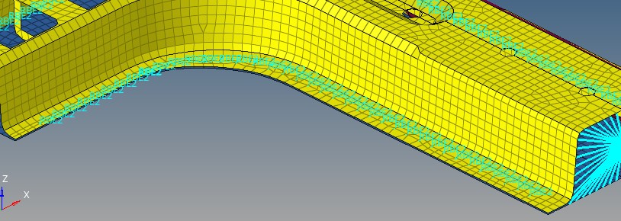
Welding spacing 25mm
Influence of number of spot weld on the stiffness
Welding spacing 50mm
Welding spacing 10mm

Slide 6

Critical analysis
Thanks to an increase in the number of spot welds and so a decrease in the Sw* parameter, it results an increase both in the torsional and bending stiffness. This is somehow expected because an higher number of welds increases the number of constraints between the 2 parts of the body, locking more the relative displacements between them, in concomitance to the fact that increasing the number of spot welds the section performs more and more as a closed one.
Sw | K_{x} | K_{z}
50 | 41 | 4363
25 | 42 | 4640
10 | 42,7 | 4784
Sw | Torsional stiffness
50 | 17425
25 | 19956
10 | 21436
*Sw means welding spacing, a parameter given to the program to change the number of welding, reducing the distance between each one. The aim is studing the behaviour of the stiffnesses of the body increasing the number of welding.

